Slide 1
Seminar 1
Introduction in ST board and ST Cube

Slide 2
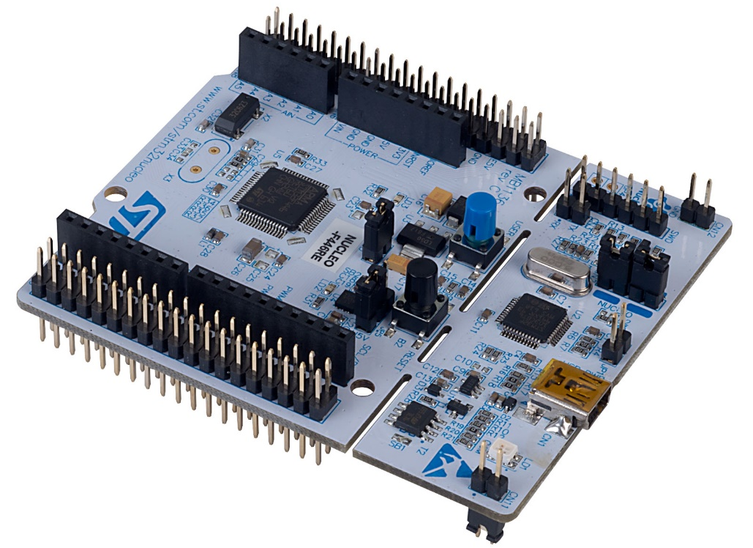
NUCLEO-G474RE /ST/ Development Kit
Dev kit selection
NUCLEO-G474RE - STM32 Nucleo-64 development board with STM32G474RE MCU, supports Arduino and ST morpho connectivity - STMicroelectronics

Slide 3
Dev kit selection
Microcontroller: STM32G474RE
- Core: ARM Cortex-M4
- Frequency: 170 MHz
- Architecture: 32-bit RISC
Memory:
- Flash Memory: 512 KB
- SRAM: 96 KB
Peripheral / Communication Interfaces:
- SPI: Dual mode QuadSPI interface,
- USB UART: 5 USART
- LIN: LIN support via USART
- I2C: 4 interfaces
- ADC: 5 x 12-bit ADCs, up to 42 channels
- DAC: 12-bit DAC, 7 channels
- GPIO: Up to 107 pins
- Timers: 17 timers
- DMA: 16 streams, 16-bit data bus
Operating System Support:
- FreeRTOS: Supported
Debugging and Programming:
- On-board Debugger: ST-Link/V2-1
- IDE Compatibility: STM32CubeIDE, Keil MDK, IAR
Embedded Workbench
Expansion:
- Arduino Uno V3 Connectivity
- ST Zio Connector
Motor Control:
- Motor Control Shields: Compatible with 3 full bridge
motors
Additional Features:
- CRC Calculation Unit
- True Random Number Generator

Slide 4
NUCLEO-F446RE Pros & Cons
Pros
- High Performance: 213 DMIPS, 170 MHz frequency
with FPU and DSP instructions.
- Memory: Large flash (512 KB)
- Extensive I/O Ports: Up to 114 I/Os, many of which are
5V-tolerant.
- Analog Capabilities: 5x 12-bit ADCs, 7x 12-bit DACs.
- Communication Interfaces: 21 interfaces including
I2C, USART, SPI, CAN, and USB OTG.
- Advanced Features: Flexible external memory
controller, LCD and camera interfaces.
- On-board ST-Link
- FreeRTOS Support debugger
- Flexible Power Options
- Affordable and Accessible: low price
- ST provides easy way to configure and generate code
templates
Cons
- Memory Limitations for large applications
- Low SRAM (96 KB)
- Less Powerful Than Cortex-M7

Slide 5

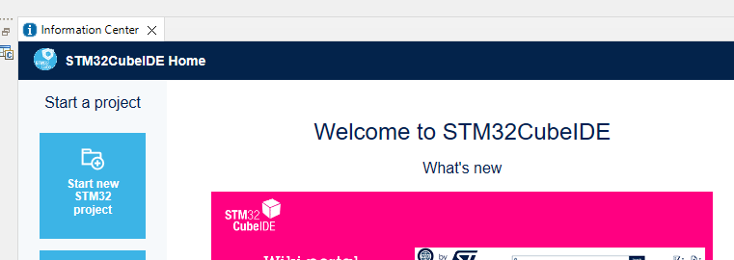
ST Cube
To configure the G474RE, STM32CubeIDE is used.
Before usage user has to be logged in:
To make a new project click on the Start New STM32 project:

Slide 6
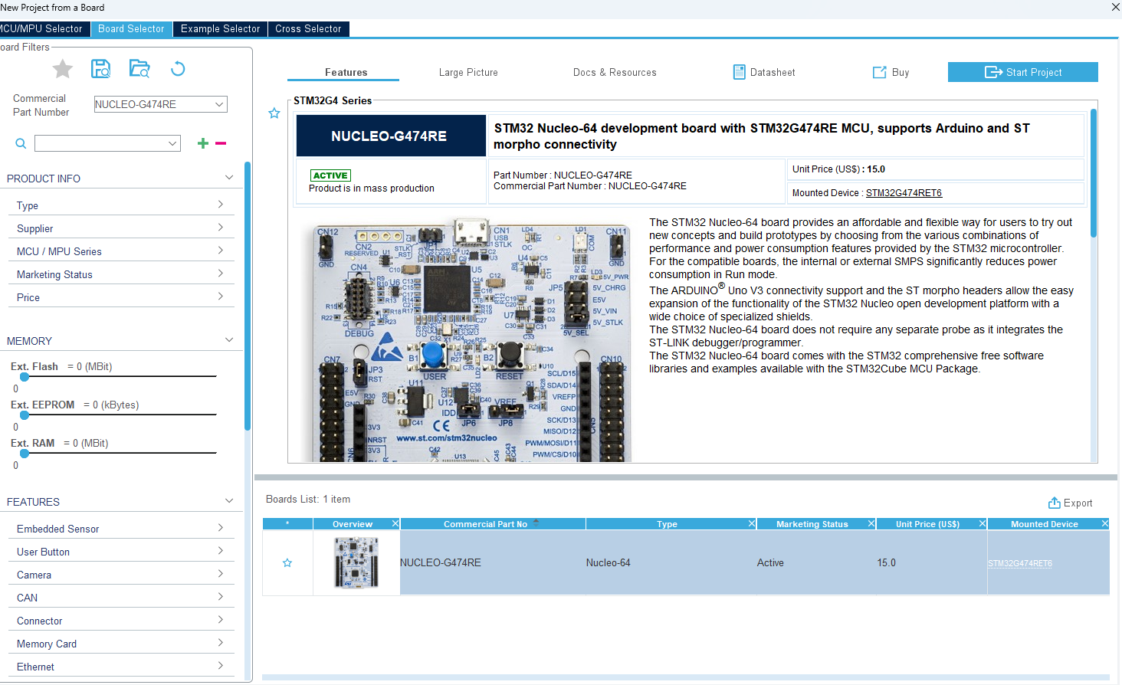
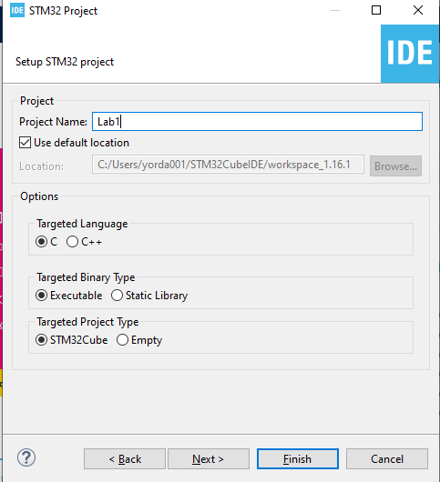
STM32CubeIDE
Select the mentioned board and click next:
Name your project e.g.: Lab1,Lab2,etc:

Slide 7
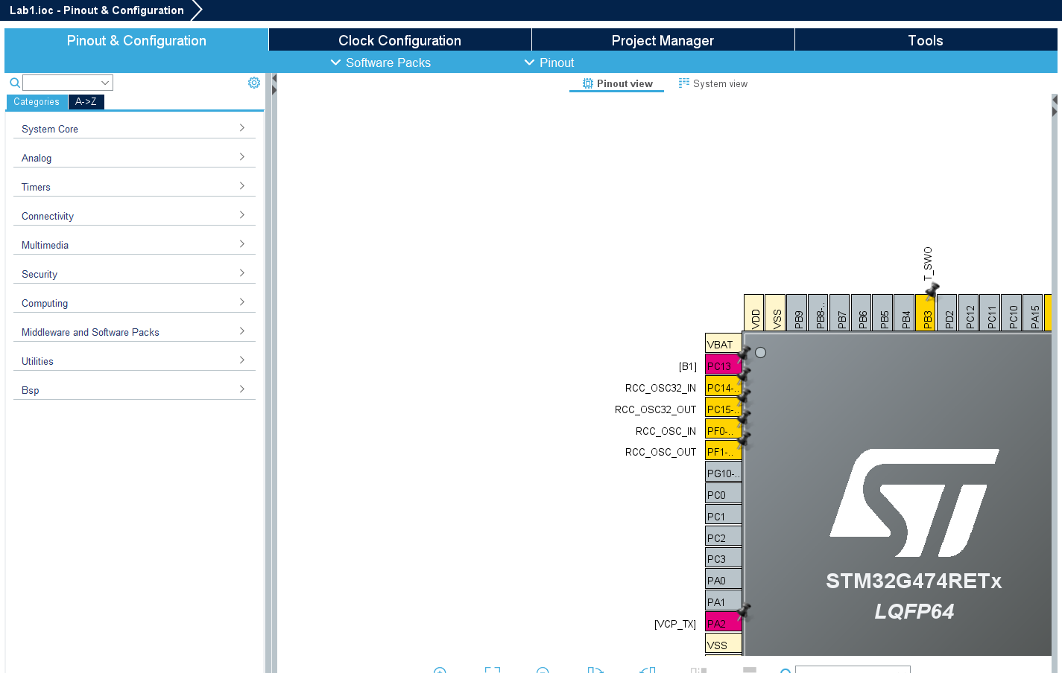
Configuration of peripherals
There are several categories:
System Core
- NVIC/DMA/Wakeup-s
Analog
- ADC/Comp/DAC
Timers
-Timers/RTC
Conectivity
-SPI/I2C/CAN/USART
Multimedia – I2S
Security - RNG
Computing – FMAC/CRC
Middeware and SW package – FreeRTOS/FATFS
Utilities – not available and not used
BSP – board support package / Led/buttons/virtual COM port

Slide 8
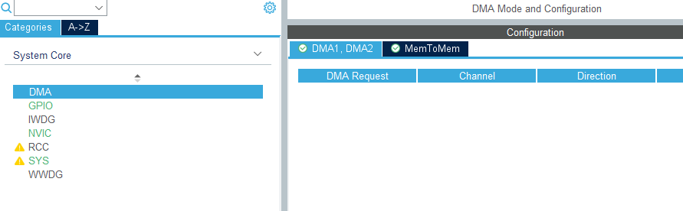
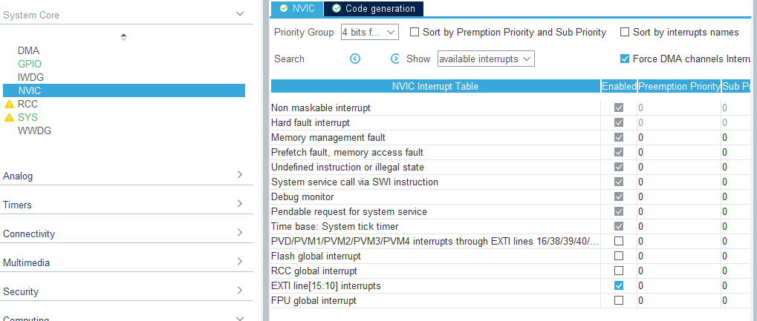
System core
In Lab Exercises, DMA will not be used.
However DMA stands for Direct memory access.
It is useful when copy of date from a source to destination is wanted, but CPU will not be involved
NVIC stands for Nested vector interrupt controller.
It is used to notify the user that something is done e.g.
SPI data was sent
ADC sampling finished
Usually in embedded systems, Interrupts are widely used.

Slide 9
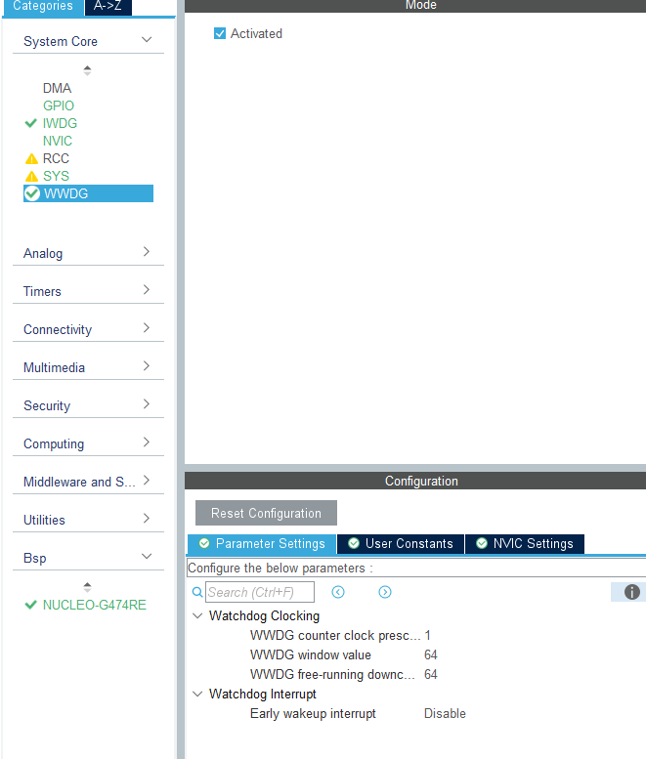
System core
Another useful peripheral from system core is WWDG (window watchdog) and IWDG(independent watchdog).
Watchdogs are used in automotive to monitor if the system is running properly and there are no deadlocks.
E.g.
If system stuck and window motor is moving, this might broke the window.
In that case when Watchdog is not serviced, a reset will be triggered and system will stops and start from the beginning.

Slide 10
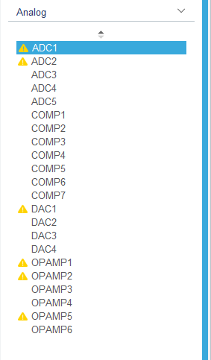
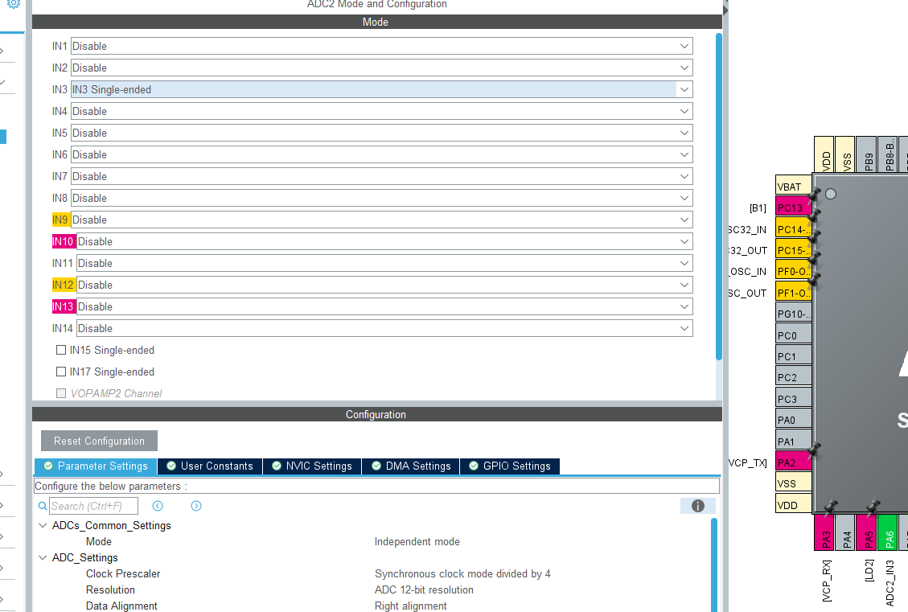
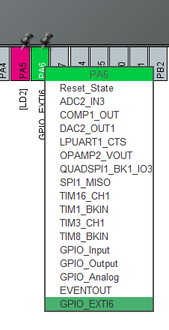
Analog
Analog section is handling the ADC(LINK), Comparators and DACs.
In the Lab exercises, only ADC will be used.
ADC is used to sample from analog signals to digital values which can be read from the MCU
If user wants to setup PA6 to ADC, it can be clicked on the PA6 and ADC2_IN3 selected, Then ADC2 and IN3 to Signal-Ended

Slide 11
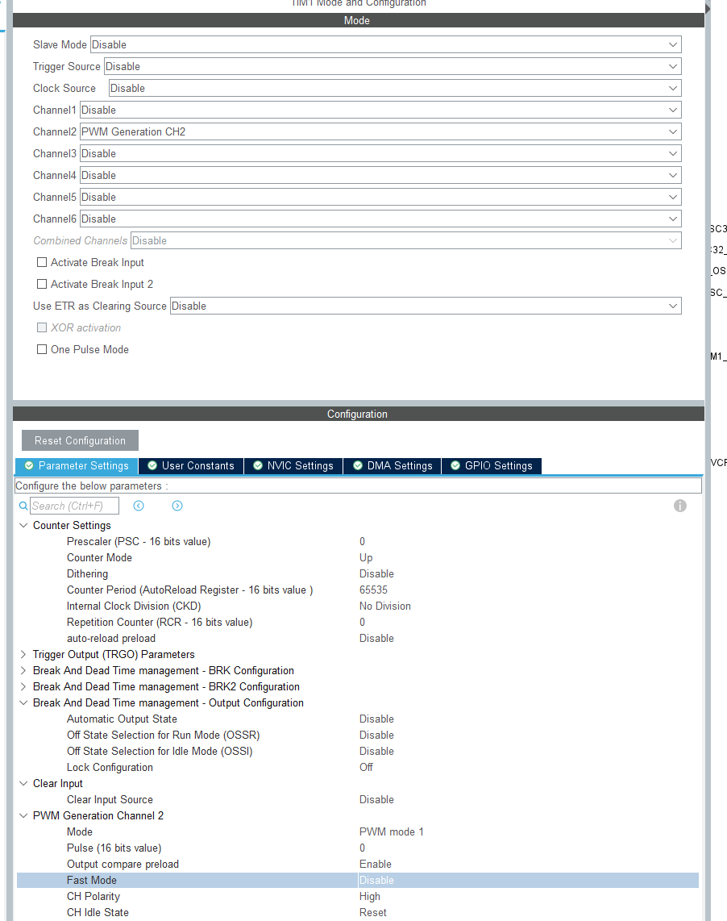
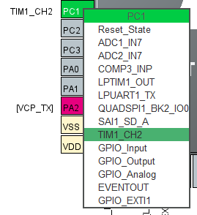
Timers
When PWM(link) is needed,
For motor speed control
For illumination intensity
It can be configure by Timers.
PWM is timer with output.
Usually there is a period and duty cycles for the PWM.
Count settings are setting the Frequency of the PWM
Pulse should be the Duty cycle.
When timer is set, pin has to be set as well (if not automatically set)

Slide 12
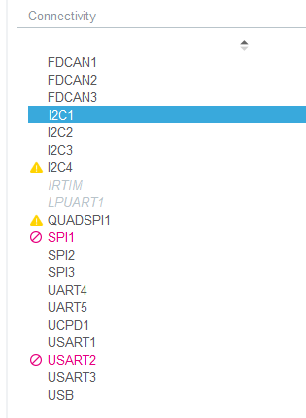
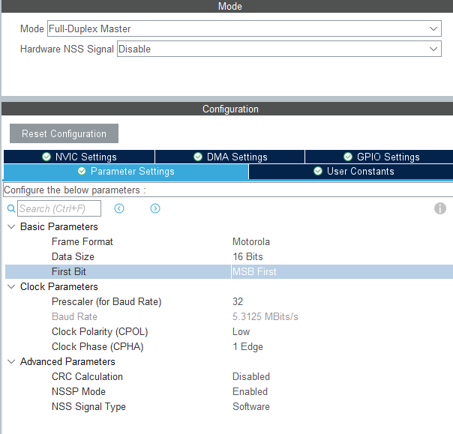
Connectivity
From connectivity U(S)ART and SPI(link) will be used.
SPI is used to communicate with the L99DZ100(later shown in the expansion board schematic)
SPI communication is used to communicate with external chips
e.g.:
Mosfet drivers
Flash memories
Accelerometers and etc.
When configure SPI several settings has to be set:
Clock polarity
Clock phase
Frequency
Data length
MSB or LSB data first

Slide 13
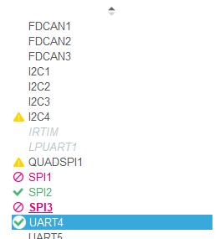
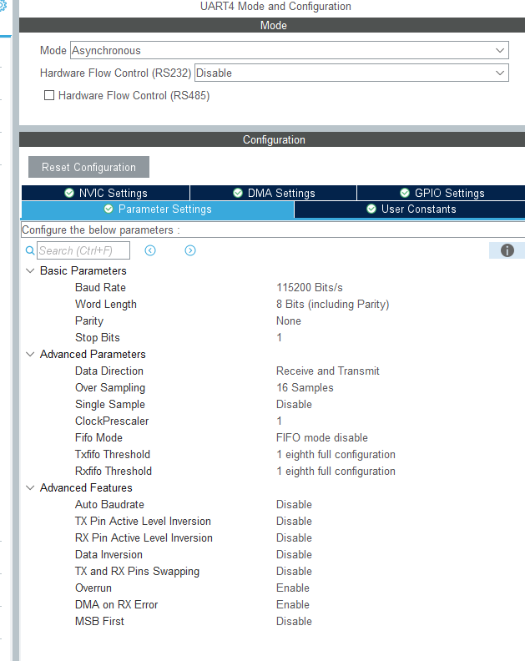

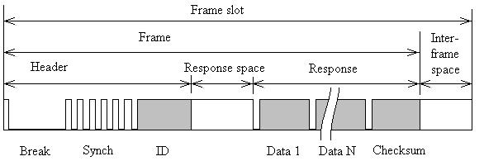
Connectivity
UART will be used for communicating between the board and PC via terminal.
The board is supporting from BSP an internal UART.
UART can be used as LIN (LINK) as well.
Lin is protocol that is used widely in the automotive. It is cheap to use and it requires only 2 wires. Lin can be found in:
Switch packs
Ambient light modules

Slide 14
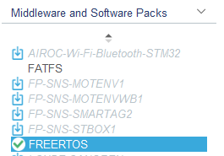
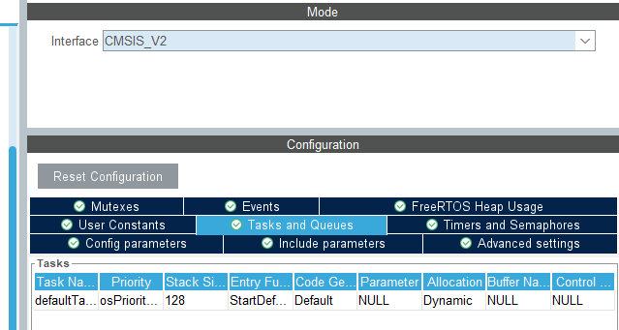
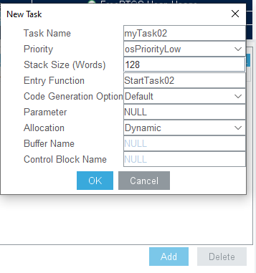
Middleware and software packs
In the exercise, next middleware and SW packs will be used.
In Automotive embedded systems, real-time OS is used all the time.
It is handling some tasks at specific time for e.g.
We have 1/2/5/10ms tasks which are reading some inputs and performing some logic.
Nevertheless STM is using FreeRTOS which is doing almost the same thing.
To add new tasks click here and there “add”

Slide 15
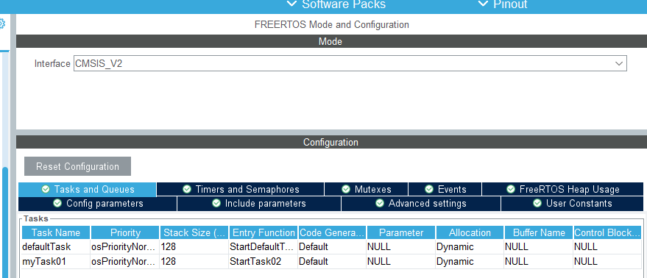
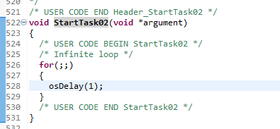
FreeRTOS
Timeslot setting is done by the code:
After creation of the task, the created task will generate code based on the entry function name.
In this case “StartTask02”
The function is generated in main.c and user code has to be implemented here
Depends on what time we want to be called we changed the osDelay, in this case, task will be called every 1ms

Slide 16
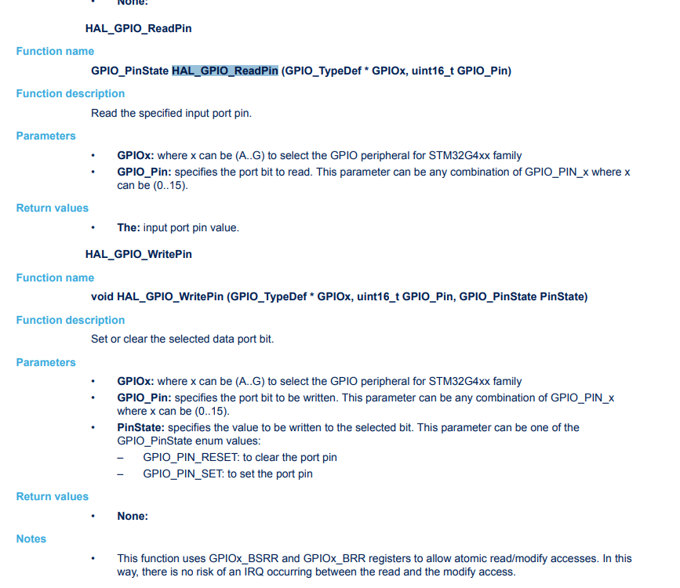
HAL functions and drivers
STM is using HAL(Hardware abstraction layer). It is providing functions which user can use to help him to read/write some pins or send something by SPI.
See:
Description of STM32G4 HAL and low-layer drivers - User manual
For example to use the HAL_GPIO_WritePin , user has to use the following format:
HAL_GPIO_WritePin(GPIOA, GPIO_PIN_15, GPIO_PIN_SET)
This will set the PinA15 to High level.

Slide 17
HAL GPIO
In the HAL GPIO we can read and control some digital outputs via following functions:
GPIO_PinState HAL_GPIO_ReadPin (GPIO_TypeDef * GPIOx, uint16_t GPIO_Pin) - Read the specified input port pin.
GPIOx: where x can be (A..G) to select the GPIO peripheral for STM32G4xx family
GPIO_Pin: specifies the port bit to read. This parameter can be any combination of GPIO_PIN_x where x can be (0..15).
void HAL_GPIO_WritePin (GPIO_TypeDef * GPIOx, uint16_t GPIO_Pin, GPIO_PinState PinState) - Set or clear the selected data port bit.
GPIOx: where x can be (A..G) to select the GPIO peripheral for STM32G4xx family
GPIO_Pin: specifies the port bit to be written. This parameter can be any combination of GPIO_PIN_x where x can be (0..15).
PinState: specifies the value to be written to the selected bit. This parameter can be one of the GPIO_PinState enum values: – GPIO_PIN_RESET: to clear the port pin – GPIO_PIN_SET: to set the port pin
void HAL_GPIO_TogglePin (GPIO_TypeDef * GPIOx, uint16_t GPIO_Pin) - Toggle the specified GPIO pin. .
GPIOx: where x can be (A..G) to select the GPIO peripheral for STM32G4xx family
GPIO_Pin: specifies the pin to be toggled. This parameter can be any combination of GPIO_PIN_x where x can be (0..15).

Slide 18

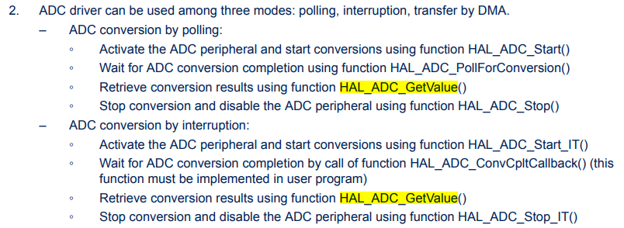
HAL ADC
If we want to read some analog values the ADC has to be used.
Some ADC applications
used to read out the position of the motor via HALL sensors
Used to read current of the motor via shunt and differential op amp.
Used to read keyboards (switchpacks) and motors feedbacks (microswitches).
ADC Can be used in Poling mode(user has to check if ADC is finished periodically), Interrupt(Interrupt will be fired when ADC sampling finished) and DMA mode(directly transfer the data to a destination w/o involving the CPU).
HAL_StatusTypeDef HAL_ADC_Start (ADC_HandleTypeDef * hadc) - Enable ADC, start conversion of regular group
hadc: ADC handle
uint32_t HAL_ADC_GetValue (ADC_HandleTypeDef * hadc) - Get ADC regular group conversion result.
hadc: ADC handle
Return values - group regular conversion data
HAL_StatusTypeDef HAL_ADC_PollForConversion (ADC_HandleTypeDef * hadc, uint32_t Timeout) - Wait for regular group conversion to be completed.
hadc: ADC handle
Timeout: Timeout value in millisecond
HAL_StatusTypeDef HAL_ADC_Stop (ADC_HandleTypeDef * hadc) - Stop ADC conversion of regular group (and injected channels in case of auto_injection mode), disable ADC peripheral.
hadc: ADC handle

Slide 19
HAL SPI
HAL_StatusTypeDef HAL_SPI_Transmit (SPI_HandleTypeDef * hspi, uint8_t * pData, uint16_t Size, uint32_t Timeout)
hspi: pointer to a SPI_HandleTypeDef structure that contains the configuration information for SPI module.
pData: pointer to data buffer • Size: amount of data to be sent
Timeout: Timeout duration
HAL_StatusTypeDef HAL_SPI_Receive (SPI_HandleTypeDef * hspi, uint8_t * pData, uint16_t Size, uint32_t Timeout) - Receive an amount of data in blocking mode.
hspi: pointer to a SPI_HandleTypeDef structure that contains the configuration information for SPI module.
pData: pointer to data buffer
Size: amount of data to be received
Timeout: Timeout duration

Slide 20
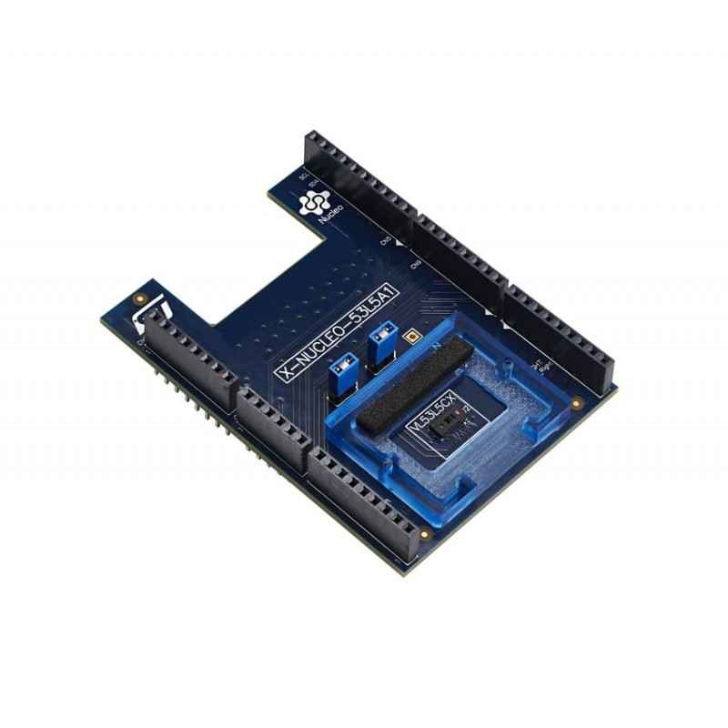
Expansion board
The board can be expanded by expansion boards on the pins with “sandwich” style board.

Slide 21
Expansion board
The expansion board which will be used for the lab exercises is custom made and it is including: - L99DZ100 (LINK) (as main chip communicating with SPI)(SBC – system basis chip)
- External flash memory
- Differential op amps used to measure current based on a shunt – ADC measurement
- Buzzer controlled with PWM
Most of the functionality are going to be driven by the L99DZ100.
- Heating for the mirror
- BLIS, puddle, Side turn indicator as illumination
- Driving of several motors

Slide 22
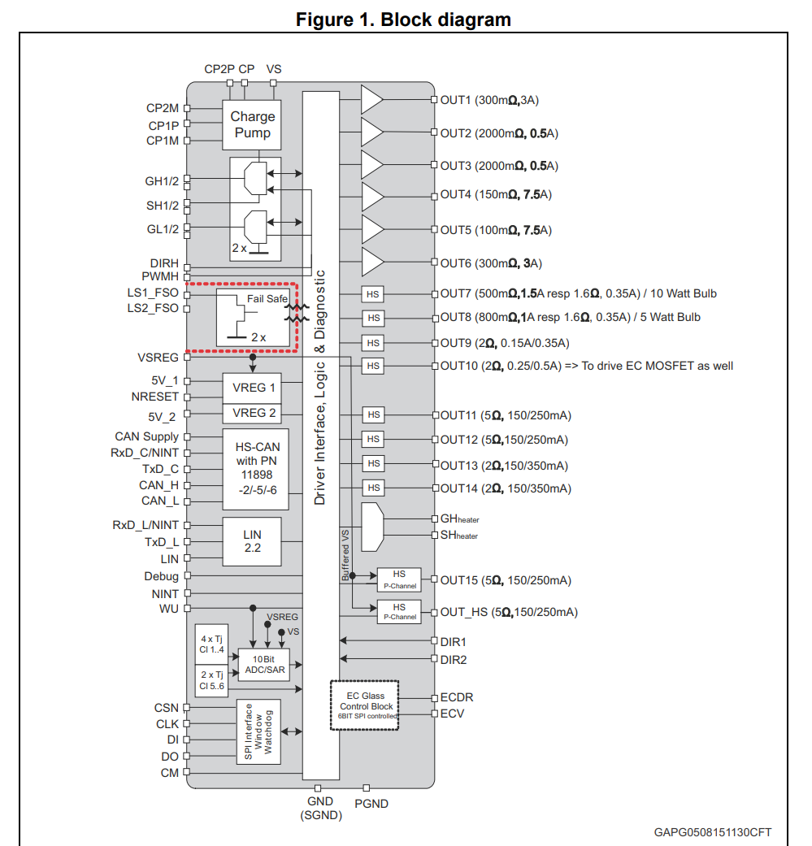
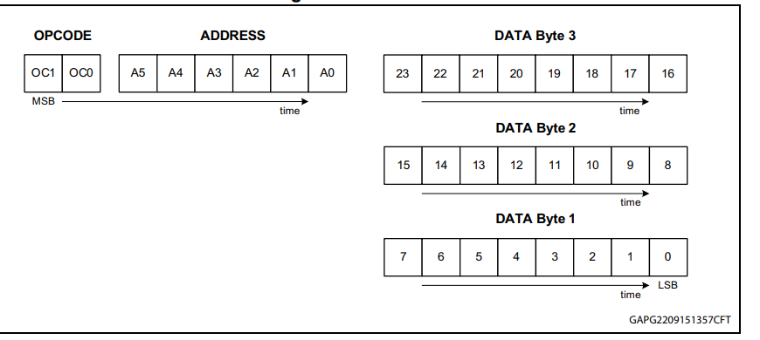
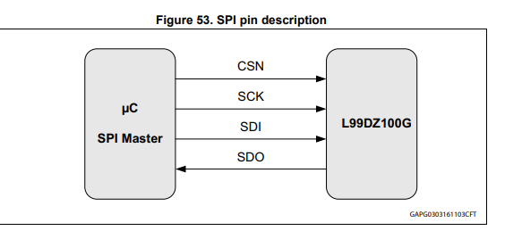
L99DZ100
L99DZ100 is a SBC(System basis chip) which have a external WDG timer, High Side drivers, Full-bridge external mosfet driver, glass heater driver, electro-chromatic driver and half bridge drivers, CAN and LIN transceivers.
It is controlled from the MCU by SPI commands.
There are internal diagnostics for all of the outputs and it can be read by the SPI as well.

Slide 23
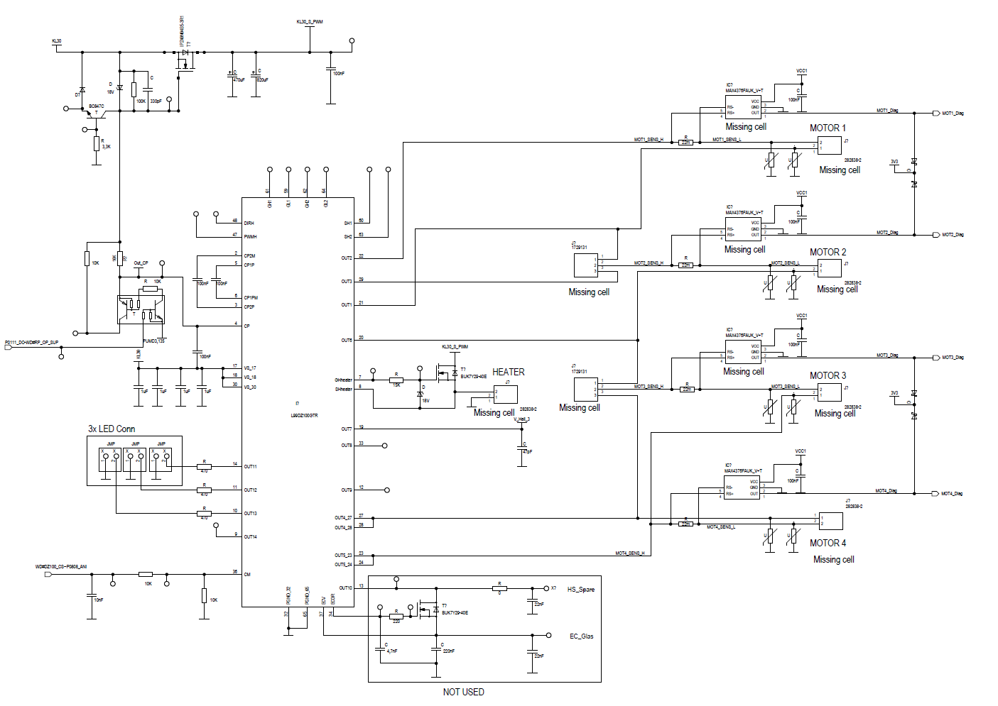
L99DZ100 at the expansion board
This is the schematic of the expansion board.
There are
3LED connectors
4 motors
Heater
Led drivers are controlled by internal HS drivers where user can set the output as a PWM controlled by SPI.
Motors are connected to Half-bridges. To drive the motors, the SW has to send command for actuating 1 LS and 1 HS. To ensure there are

